Slide 1

f
Presentation
on
“Pothole Dimension Detection Using YOLOv8”
DEPARTMENT OF COMPUTER SCIENCE & ENGINEERING
CAY 2024-2025
Presented by:
ADITYA KADIMDIWAN 2JH21CS008
PRATHAM KUBSAD 2JH21CS072
PUSHPA NAYAK 2JH21CS075
SAHANKUMAR POL 2JH21CS085
Guided by:
Prof. Praveen Hongal
Dept of Computer Science
& Engineering

Slide 2
Contents
INTRODUCTION
LITERATURE SURVEY
MOTIVATION
OBJECTIVES
PROBLEM STATEMENT
REQUIREMENT ANALYSIS
METHODOLOGY
IMPLEMENTATION
APPLICATIONS
RESULTS AND DISCUSSION
CONCLUSION AND FUTURE WORK
REFERENCES
Dept of CSE, JCET, Hubballi 2024-2025 1

Slide 3
INTRODUCTION
Machine Learning (ML) enables systems to learn from data and improve over time without explicit programming.
Object detection is a key ML application used in areas like autonomous driving, surveillance, and infrastructure monitoring.
Manual pothole detection is inefficient, risky, and error-prone, requiring automation.
ML and computer vision provide scalable, real-time solutions for road analysis and pothole detection.
Dept of CSE, JCET, Hubballi 2021-2025 2

Slide 4
YOLO (You Only Look Once) is a fast and accurate real-time object detection frame work.
YOLOv8 offers high precision and speed, making it ideal for detecting potholes in real-time images and videos.
The system integrates with webcams and mobile cameras (via DroidCam) for live detection.
Supports future enhancements like GPS tagging, real-time alerts, and automated maintenance systems.
Dept of CSE, JCET, Hubballi 2021-2025 3

Slide 5
LITERATURE SURVEY
Title : Real-time Pothole Detection using YOLOv5 Algorithm: A Feasible Approach for Intelligent Transportation Systems
Author | Year | Methodology | Limitations
Santhosh R, Alfred Daniel J | 2023 | The authors proposed a real-time pothole detection framework using the YOLOv5 deep learning algorithm. The model processes road images and videos to detect potholes with high accuracy and speed, suitable for deployment on edge devices such as onboard vehicle systems. The system includes data collection, annotation, model training, and conversion to OpenVino IR format for real-time detection. | Limited performance under poor image conditions and prone to false positives from similar road features.
Dept of CSE, JCET, Hubballi 2021-2025 4

Slide 6
Title: Pothole Detection using Image Processing and Machine Learning
Author | Year | Methodology | Limitations/ Future Work
T.C. Mahalingesh, Anubhav | 2024 | This paper introduces an automated pothole detection and filling system using the YOLOv8 object detection algorithm integrated with Raspberry Pi, PiCamera, and Arduino Mega. YOLOv8 was trained via transfer learning to detect potholes in real-time, with further verification using ultrasonic sensors for accurate depth assessment. Once confirmed, a pump system fills the pothole with a diluted cement mix. | Real-time performance may degrade on low-powered devices, at high
Dept of CSE, JCET, Hubballi 2021-2025 5

Slide 7
Title : Design, Development and Testing of Automatic Pothole Detection and Alert System
Author | Year | Methodology | Limitations
Dhwani Desai | 2019 | This paper proposes a system combining ultrasonic sensors, accelerometers, stereo cameras, and GPS modules on a Raspberry Pi-based platform. It detects potholes and speed breakers in real-time, calculates their dimensions, and sends alerts using SMTP. | Cost-efficient but limited in scalability across weather and lighting conditions; relies on combined sensor input for accurate detection.
Dept of CSE, JCET, Hubballi 2021-2025 6

Slide 8
MOTIVATION
Potholes pose a serious threat to road safety, causing vehicle damage, traffic congestion, and accidents, especially in poorly maintained urban and rural roads. Manual inspection and maintenance are inefficient, time-consuming, and lack scalability for real-time monitoring. Motivated by the need for an automated, accurate, and efficient solution, this project leverages advanced computer vision and deep learning technologies, particularly the YOLOv8 model, to detect potholes from images, videos, and real-time camera feeds.
Dept of CSE, JCET, Hubballi 2021-2025 7

Slide 9
OBJECTIVES
Develop a YOLOv8-based system for real-time pothole detection from images, videos, and live feeds.
Estimate pothole dimensions using pixel-to-meter conversions.
Build a web interface supporting uploads, live detection, and user interaction.
Integrate dual-camera support and lay groundwork for GPS tagging and pothole database logging.
Dept of CSE, JCET, Hubballi 2021-2025 8

Slide 10
PROBLEM STATEMENT
Manual road inspections are inefficient and often miss critical potholes. There's a need for an automated system that detects potholes in real-time from images, videos, and live feeds, while estimating their dimensions to support timely road maintenance and enhance safety.
Dept of CSE, JCET, Hubballi 2021-2025 9

Slide 11
REQUIREMENT ANALYSIS
Functional Requirements:
The system detects potholes in images, videos, and real-time camera feeds.
Users will be able to upload media files for detection.
The system returns detection results with bounding boxes and dimensions.
A real-time feed activates detection via webcam or mobile (DroidCam).
The frontend communicates with the backend API for inference.
Dept of CSE, JCET, Hubballi 2021-2025 10

Slide 12
Non-Functional Requirements:
The system provides results within a few seconds (low latency).
It supports mobile and desktop browser compatibility.
The backend remains responsive under concurrent requests.
The detection model has at least 80% accuracy
Dept of CSE, JCET, Hubballi 2021-2025 11

Slide 13
Software and Hardware Requirements
Category | Requirements | Description
Hardware | CPU | Intel i5
 | GPU | NVIDIA GPU (e.g. RTX 3050)
 | RAM | Minimum 8GB
 | Storage | At least 512GB HDD/SDD
Dept of CSE, JCET, Hubballi 2021-2025 12

Slide 14
Category | Requirements | Description
Software | Operating System | Windows 11
 | Programming Language | Python 3.8 Streamlit FASTApi
 | Dataset Tools | ROBOFLOW
Dept of CSE, JCET, Hubballi 2021-2025 13

Slide 15
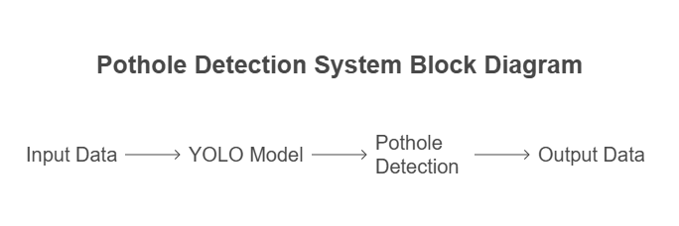
METHODOLOGY
Fig : Existing Pothole Detection System
Dept of CSE, JCET, Hubballi 2021-2025 14

Slide 16
Existing systems lack real-time detection, mobile deployment, and accurate dimension estimation.
Proposed model uses YOLOv8 for real-time pothole detection from images, videos, and live camera feeds.
Supports GPS tagging, visual overlays, and alerts for enhanced user safety and city infrastructure monitoring.
Pre-processing includes image augmentation, normalization, and YOLO-format annotation to improve model robustness.
Dept of CSE, JCET, Hubballi 2021-2025 15

Slide 17
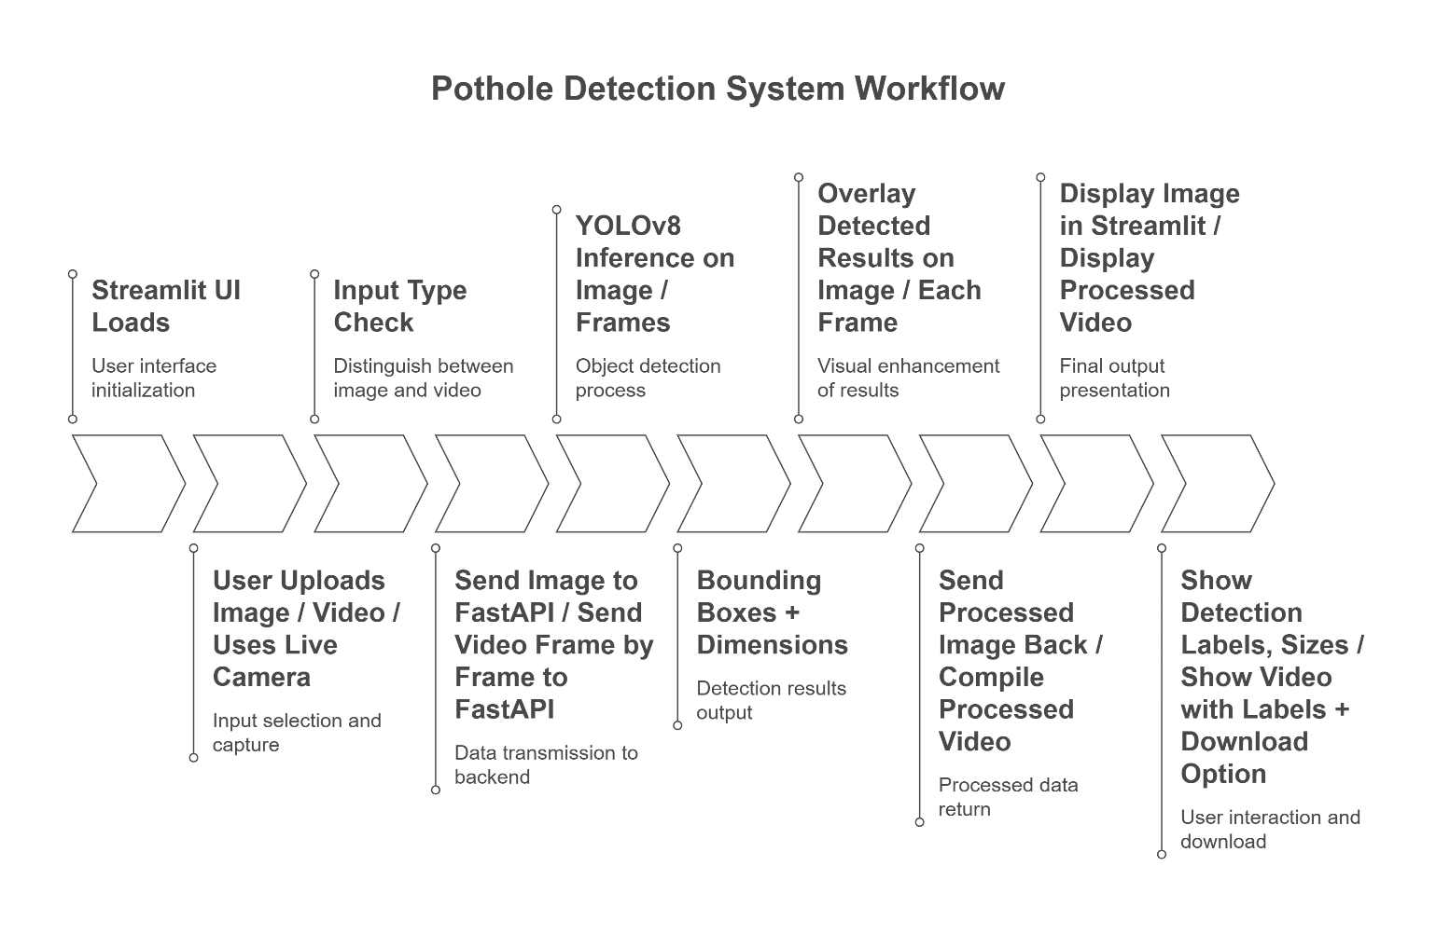
IMPLEMENTATION
Dept of CSE, JCET, Hubballi 2021-2025 17

Slide 18
APPLICATIONS
Smart City Infrastructure Management
Automates the process of identifying and measuring potholes on urban roads.
Enables municipalities to create real-time road health maps for maintenance planning.
Road Maintenance Prioritization
Helps civic authorities prioritize repairs based on pothole dimensions and frequency.
Reduces manual inspections by providing accurate digital logs.
Driver Safety and Navigation Assistance
Can be integrated with in-vehicle camera systems to alert drivers of upcoming potholes.
Improves vehicle safety by minimizing unexpected jolts or accidents.
Traffic Management and Rerouting
Helps traffic systems reroute vehicles away from severely damaged roads.
Can be used in dynamic traffic control systems and navigation apps.
Dept of CSE, JCET, Hubballi 2021-2025 18

Slide 19
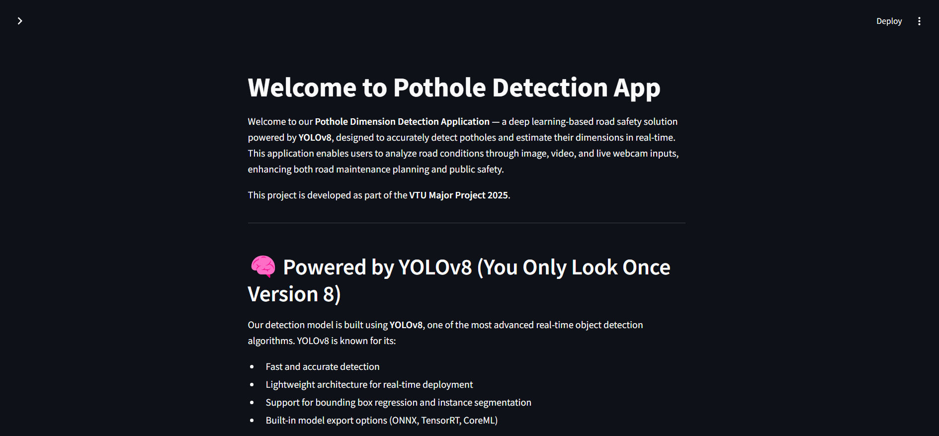
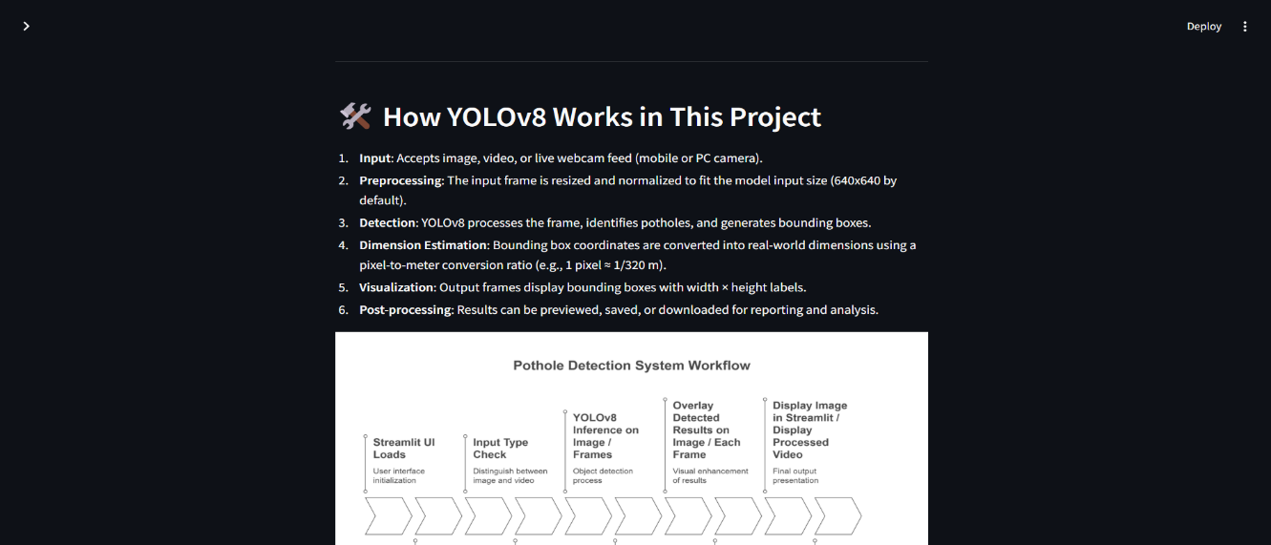
RESULTS AND DISCUSSIONS
Fig 1: HomePage
Fig 2: About Section
Dept of CSE, JCET, Hubballi 2021-2025 19

Slide 20
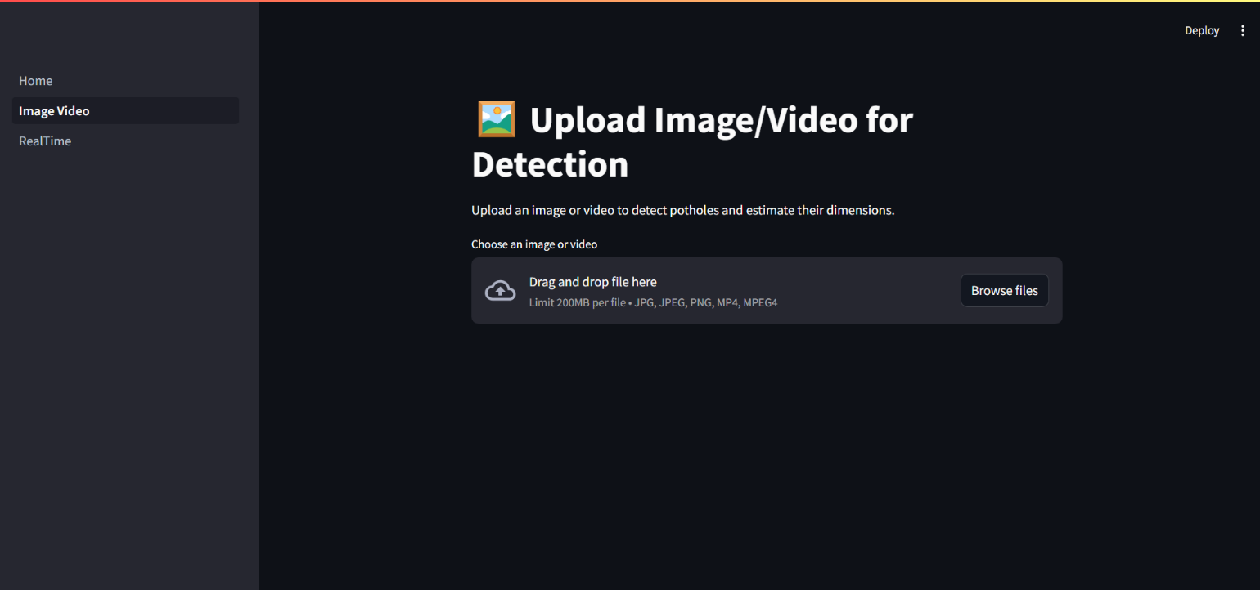
Fig 3:Image and Video Input
Dept of CSE, JCET, Hubballi 2021-2025 20

Slide 21
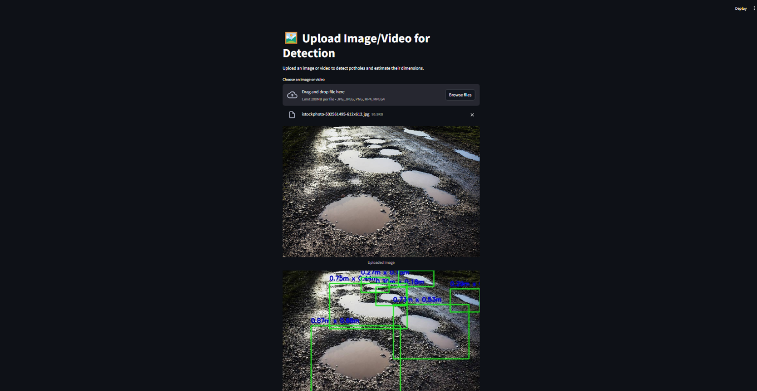
Fig 4 : Image Pothole Detected
Dept of CSE, JCET, Hubballi 2021-2025 21

Slide 22
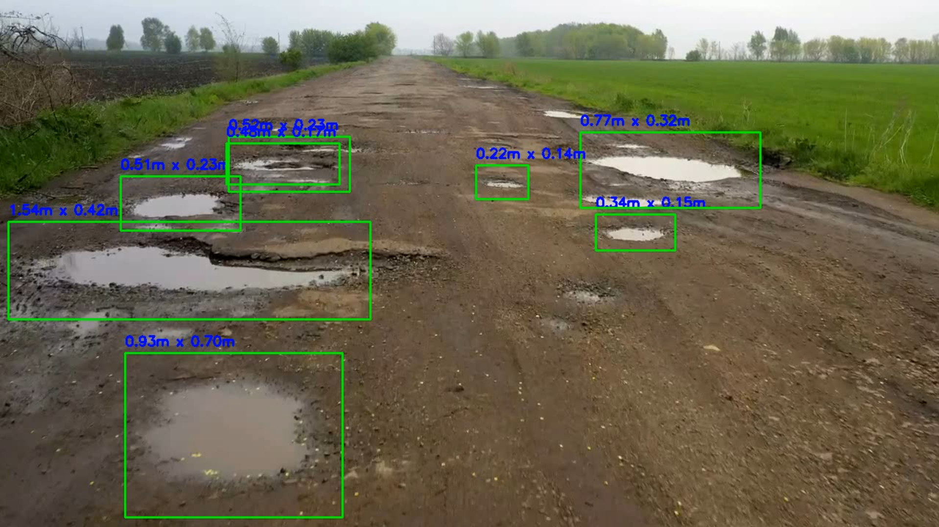
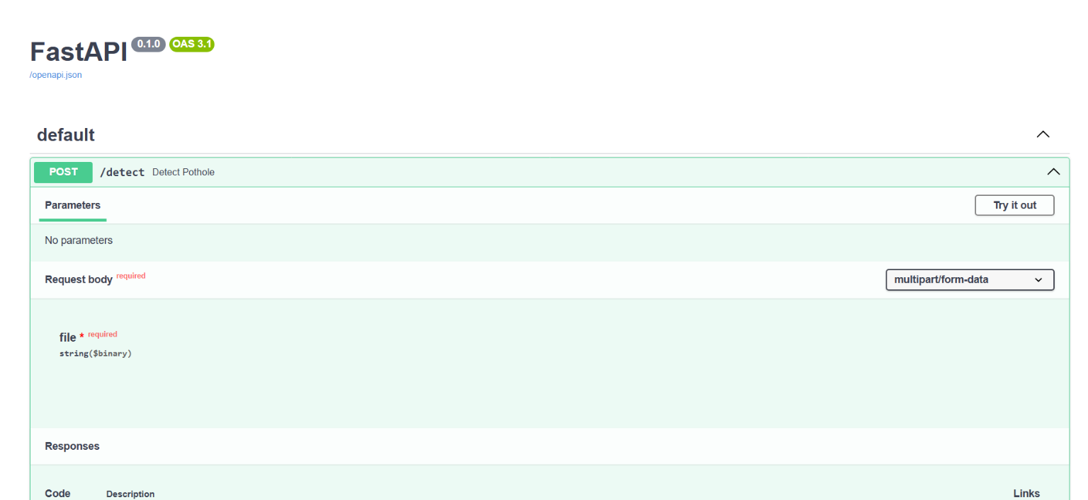
Fig 5 : Video Output
Fig 6 : Backend Server
Dept of CSE, JCET, Hubballi 2021-2025 22

Slide 23
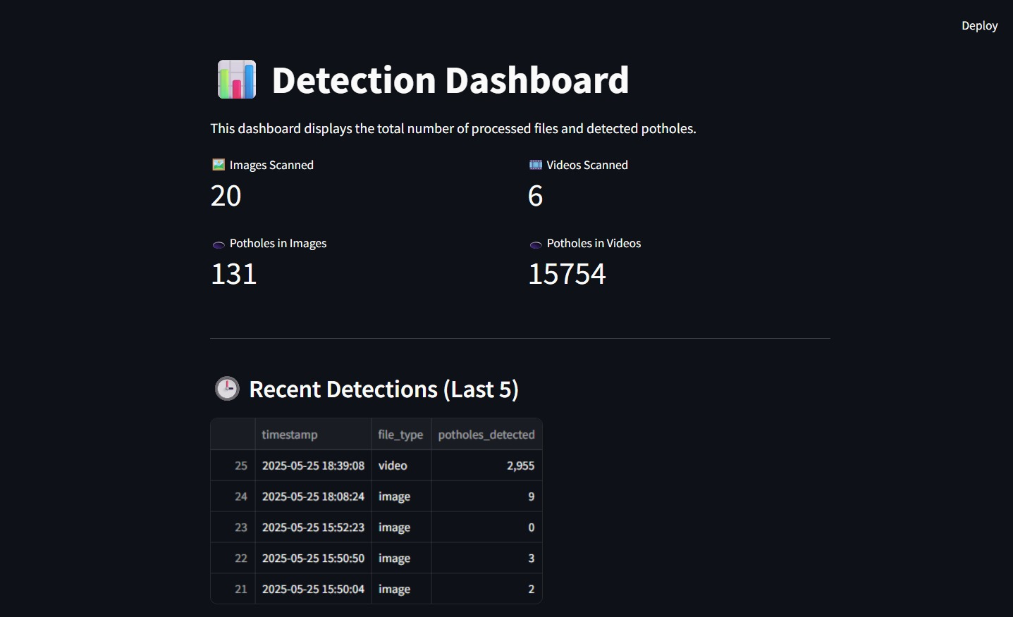
Fig: Dashboard
Dept of CSE, JCET, Hubballi 2021-2025 23

Slide 24
CONCLUSION
The Pothole Dimension Detection system developed in this project presents a practical and intelligent solution for automated road damage monitoring using deep learning. Leveraging the YOLOv8 detection model, the system is capable of accurately identifying potholes and estimating their real-world dimensions across various input modes image, video, and real-time camera feeds. This multi-input flexibility makes the system suitable for both offline analysis and live road surveillance.
Dept of CSE, JCET, Hubballi 2021-2025 24

Slide 25
FUTURE SCOPE
GPS-Based Alerts for Drivers Future versions of the system will integrate real-time GPS functionality to:
Trigger early warnings when a pothole is detected within a 100-meter radius
Enhance driver safety with location-based alerts
Potentially integrate with navigation apps or onboard vehicle systems
2. Public QR Access & API Usage Tracking A QR code will be generated and distributed, linking to the project's public facing homepage or dashboard.
This platform will:
Allow users to view their detection history (date, time, file type, count)
Provide API keys for developers to access the /detect endpoint
Implement a scan-limited freemium model, where users get a limited number of free detections before switching to a subscription plan
Dept of CSE, JCET, Hubballi 2021-2025 25

Slide 26
REFERENCES
Pothole Detection using Image Processing Techniques – IEEE Xplore, https://ieeexplore.ieee.org
Real-Time Pothole Detection using YOLOv5 – IJERT, 2022.
Roboflow – Annotating and Exporting Custom Datasets https://roboflow.com
Dept of CSE, JCET, Hubballi 2021-2025 26

Slide 27
Q and A

Slide 28
Thank you

